Slide 1
MTU LUG
General Meeting

Slide 2
Announcements
First General Meeting
Elections are open, please submit your nominations
VP, secretary, and treasurer
What do we want to do?
Nanocon? (still here?)
nanocon-l@mtu.edu
Wednesday 6PM -- Fisher 131(TBH who knows?)

Slide 3
eBoard Updates
Pres update
VP update
Server Team update

Slide 4
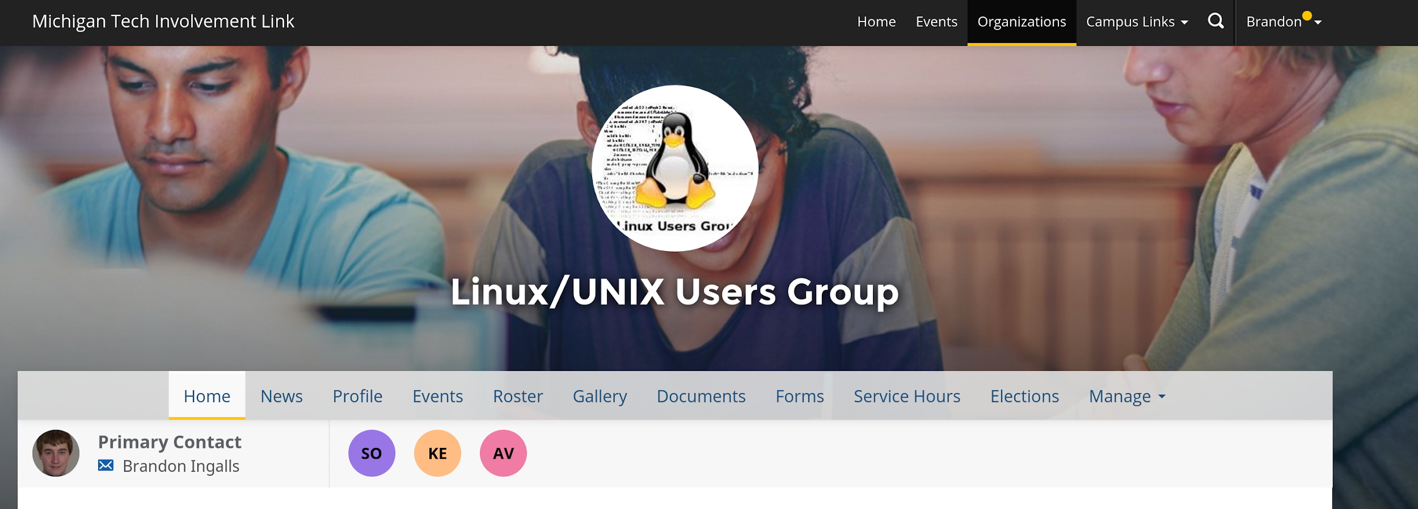
Join on Involvement
https://www.involvement.mtu.edu/organization/lug

Slide 5
Join lug-l
Join us on;
Slack mtulug.slack.com
Use mtu email
IRC
THESE ------------------>

Slide 6
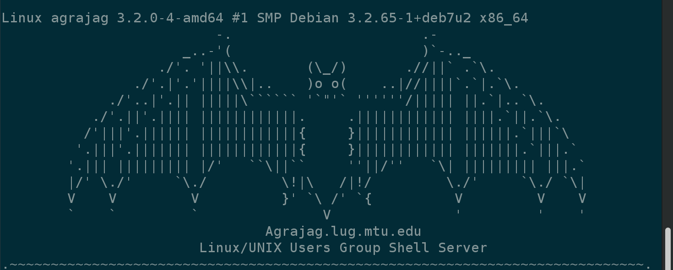
Shell Server
Account if
have been to three general meetings
shell.lug.mtu.edu

Slide 7
LUG eBoard Elections
Nominated
Vice-President
Alec Hitchiner
Eric Steve
Paul esch-laurent
Alex Kagno
Secretary
Eric Steve
Paul esch-laurent
Treasure
Alec Hitchiner
Paul esch-laurent

Slide 8
LUG eBoard Elections
Filled
President
Zach Jones
Sysadmins
Matt Miller
Zach Jones
Todd Fox

Slide 9
Fun-Time
Any topics of Interest you would like to discuss this year?
Anything you would like to do?
T-shirts?

Slide 10
What fun thing did you do
this week?
What did you break?

