Slide 1
MTU LUG
General Meeting

Slide 2
Announcements
2nd Meeting
Jake Black is at the USG meeting, I hope
Start thinking about elections
Pres, VP, Server Admins (all?), secretary?, maybe treasurer?
Nanocon?
nanocon-l@mtu.edu
Wednesday 6PM -- Fisher 131

Slide 3
eBoard Updates
Pres update
VP update
Server Team update

Slide 4
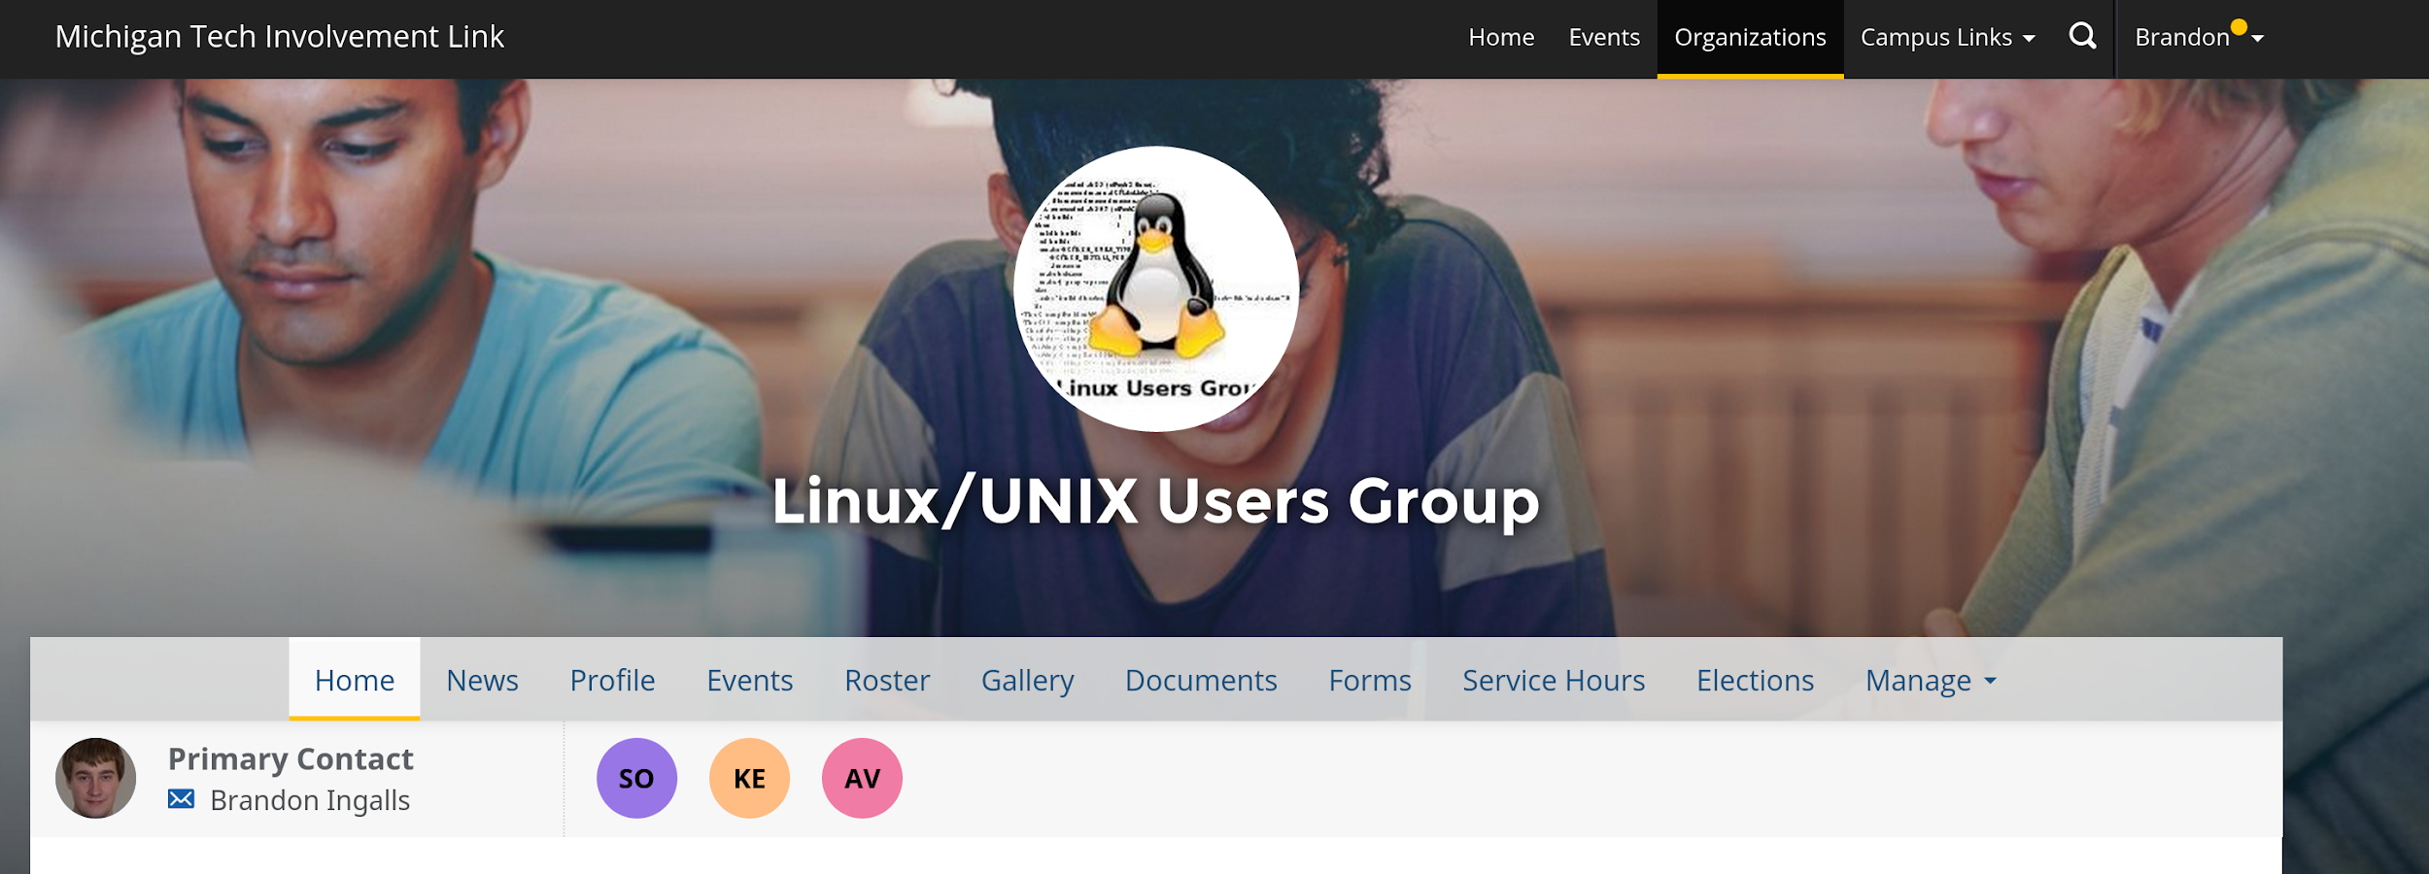
Join on Involvement
https://www.involvement.mtu.edu/organization/lug

Slide 5
Join lug-l
Join us on;
Slack mtulug.slack.com
Use mtu email
IRC
THESE ------------------>

Slide 6
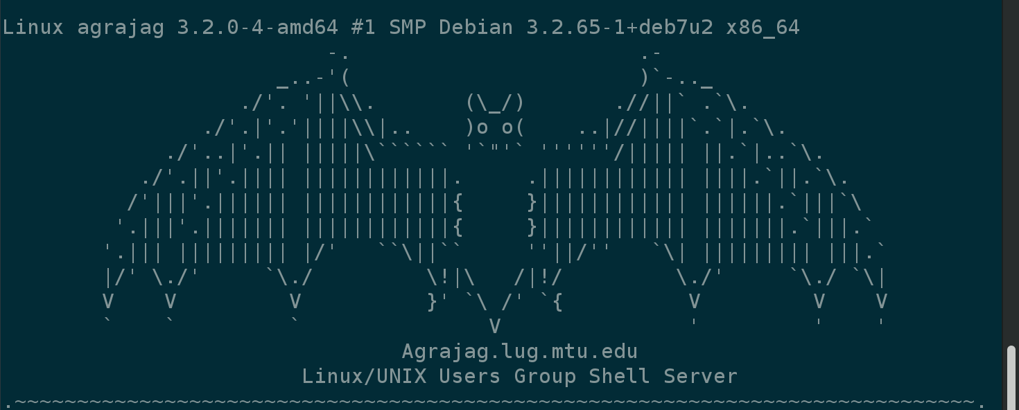
Shell Server
Account if
have been to three general meetings
shell.lug.mtu.edu

Slide 7
Fun-Time
What did you break this week or over break

Slide 8
Questions?
Any questions?

