Slide 1
MTU LUG
General Meeting

Slide 2
Announcements
LEAGUE OF LEGENDS TOURNEY Tomorrow
hype
Nanocon?
nanocon-l@mtu.edu
Wednesday 6PM -- Fisher 131

Slide 3
eBoard Updates
nominations for Secretary
Server Team update
What services should we host
What mirrors should we host
Any eBoard positions that need the floor

Slide 4
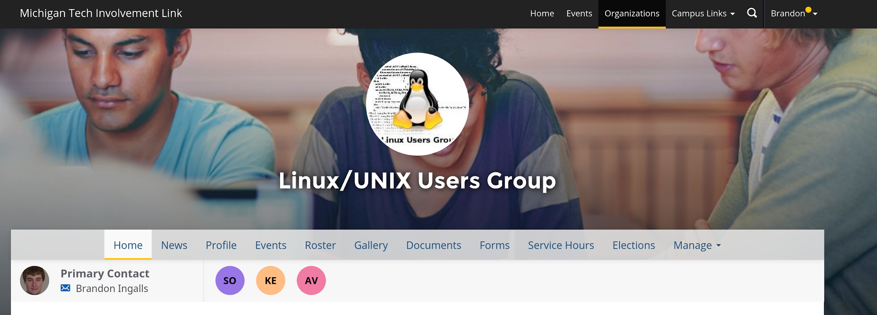
Join on Involvement
https://www.involvement.mtu.edu/organization/lug

Slide 5
Join lug-l
Join us on;
Slack mtulug.slack.com
Use mtu email
IRC
THESE ------------------>

Slide 6
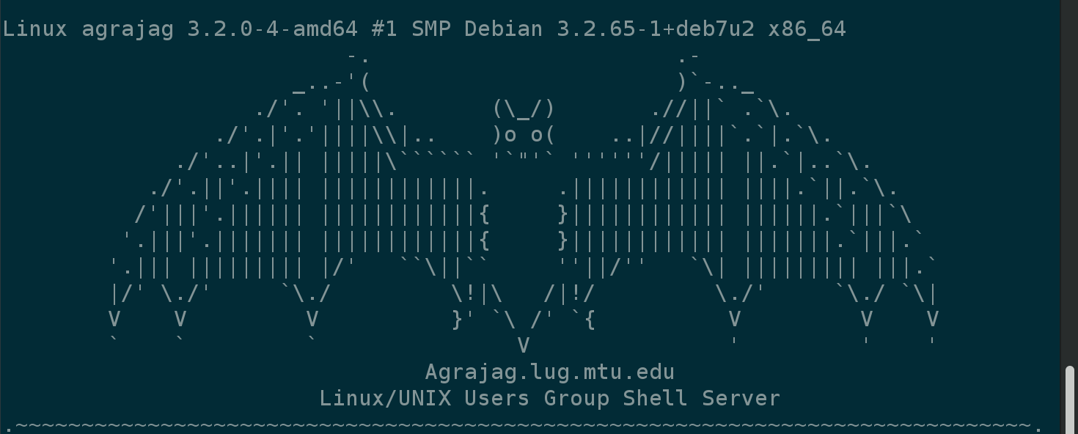
Shell Server
Account if
have been to three general meetings
shell.lug.mtu.edu

Slide 7
Tonight’s Quick Topic
Final count for people wanting to help LoL tourney
Anyone looking to take it over
If you have a topic you want to cover let us know
Thoughts on possibly being test subjects for my senior project

Slide 8
Fun-Time
What did you break this week
open-discussion

Slide 9
Questions?
Any questions?

