Slide 1
MTU LUG
General Meeting 2015-12-04

Slide 2
Join lug-l

Slide 3
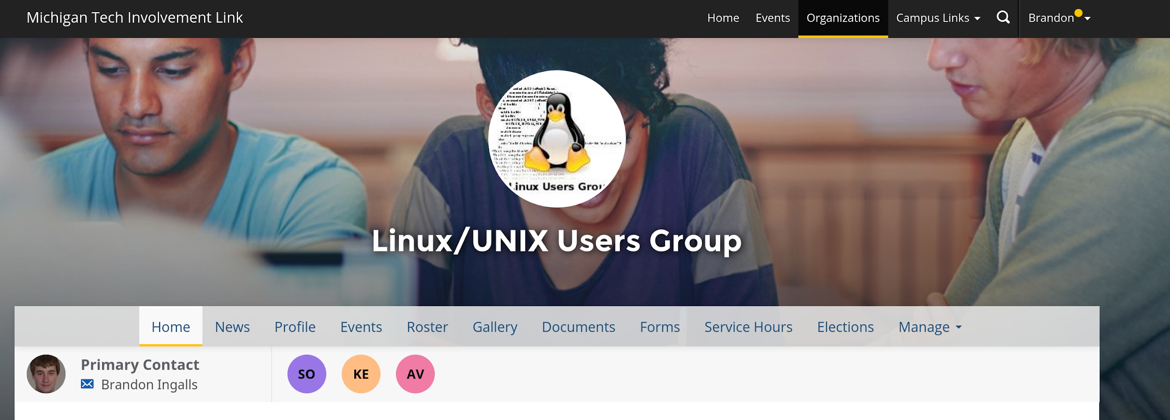
Join on Involvement
https://www.involvement.mtu.edu/organization/lug

Slide 4
Announcements
Elections for next semester

Slide 5
Election Stuffs
LUG officer terms = 1 semester
Anybody want to be part of E-Board?
Nominate self
Involvement Link will host election next week

Slide 6
Users Forum
https://mtulug.slack.com/

Slide 7
Alec’s Presentation
Take it away Alec

