Slide 1
MTU LUG
General Meeting 2015-11-06

Slide 2
Join lug-l

Slide 3
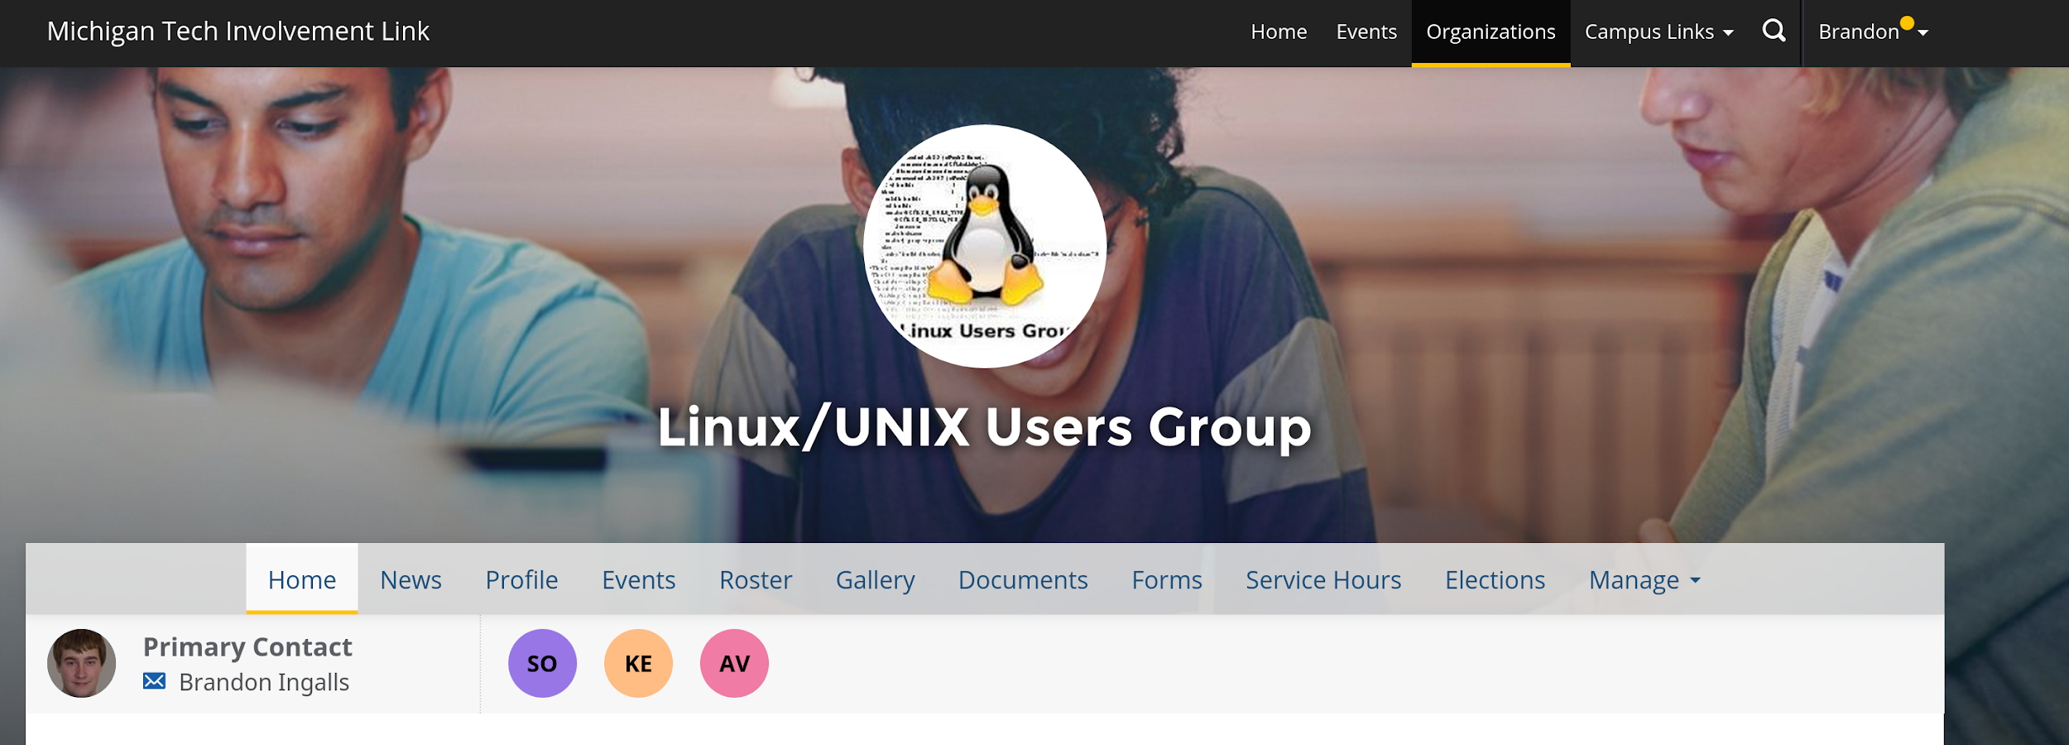
Join on Involvement
https://www.involvement.mtu.edu/organization/lug

Slide 4
Announcements
LoL thing tonight I guess
This meeting will be a bit short
Go spectate?
Cancel General meeting 2015-11-20?
Thanksgiving Break starts that night
Vote

Slide 5
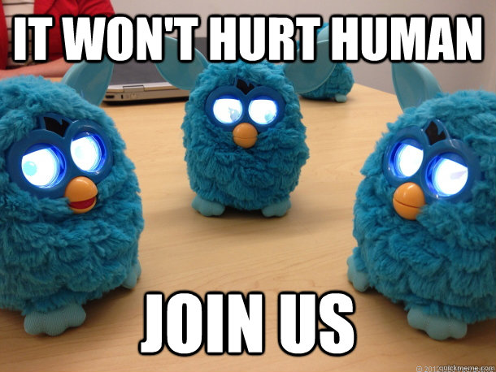
Start thinking about elections
We need replacements

Slide 6
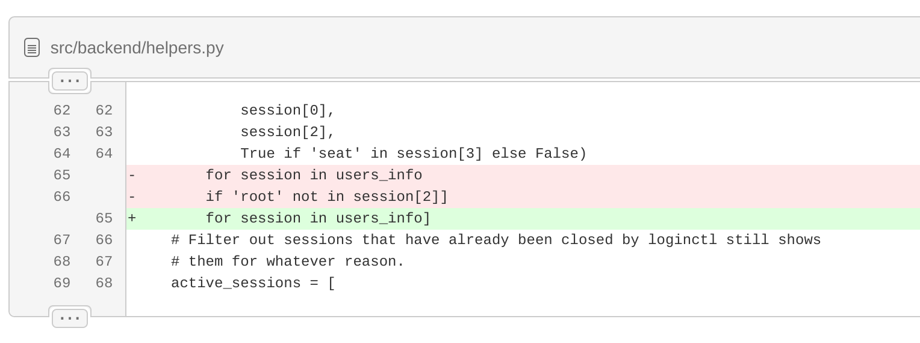
Users Forum
https://mtulug.slack.com/
blingall broke admin login...

Slide 7
No Presentation
blingall will work on the Red vs Blue presentation
Try to find ways to stop one person from ruining the fun of everyone

