Slide 1
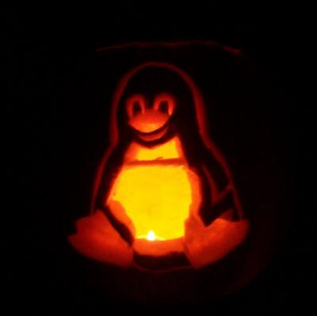
MTU LUG
General Meeting

Slide 2
Join lug-l

Slide 3
Announcements
“New” Server!
Still need SAS drives and rails
Thanks MTU IT!
DoD Rep
Oct 30 / Today
Unable to make it
Will reschedule for some time later
https://www.twitchinstalls.com/
Twitch… Arch Linux

Slide 4
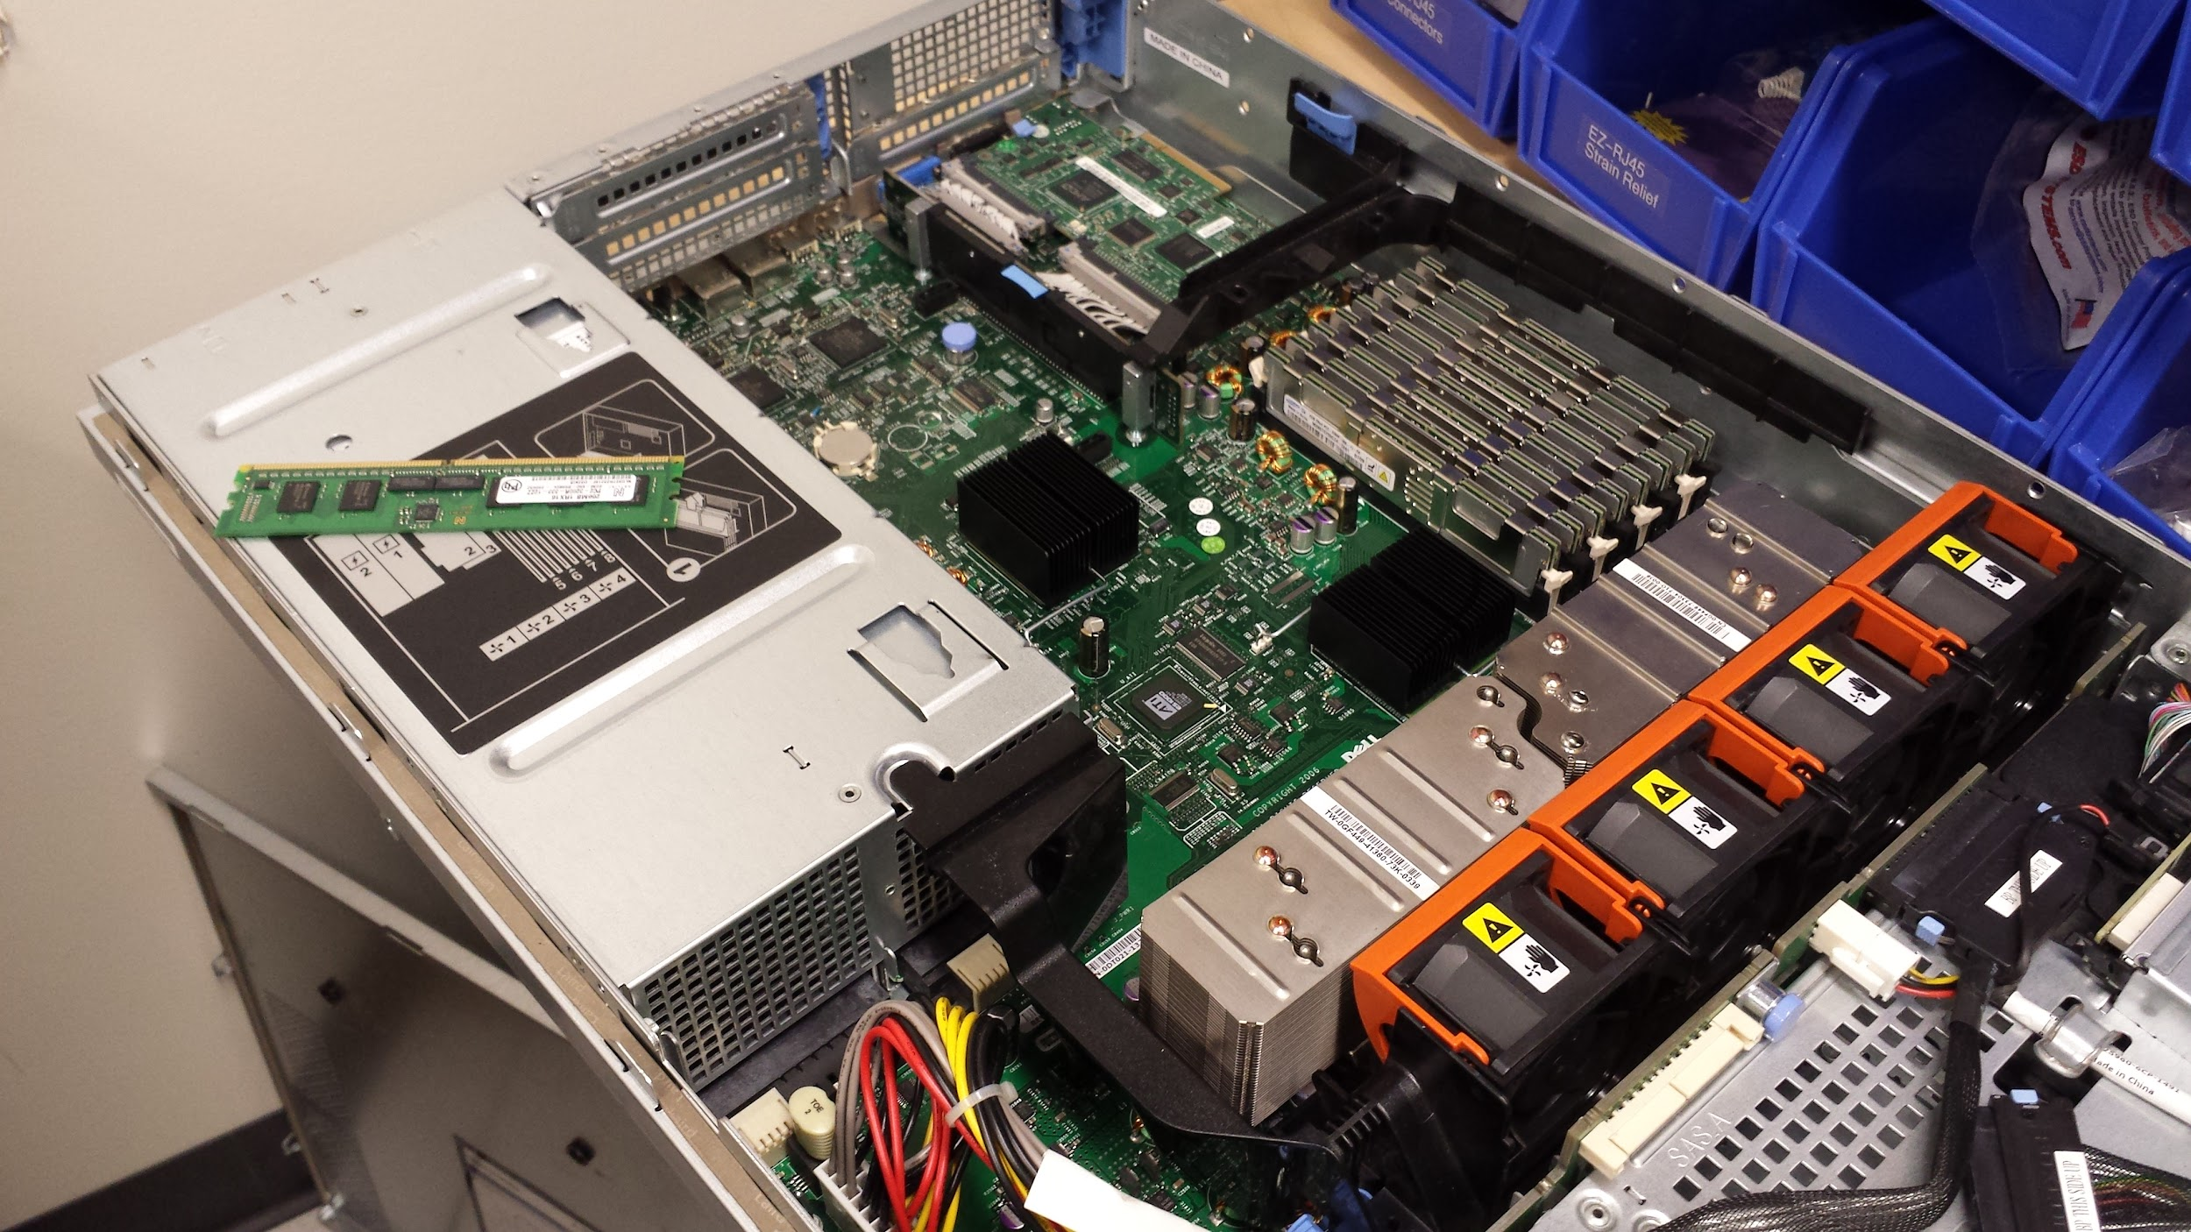
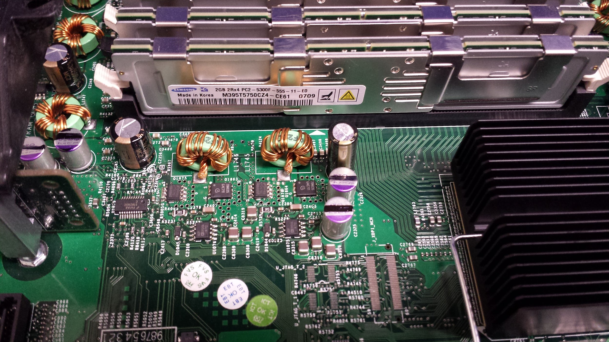
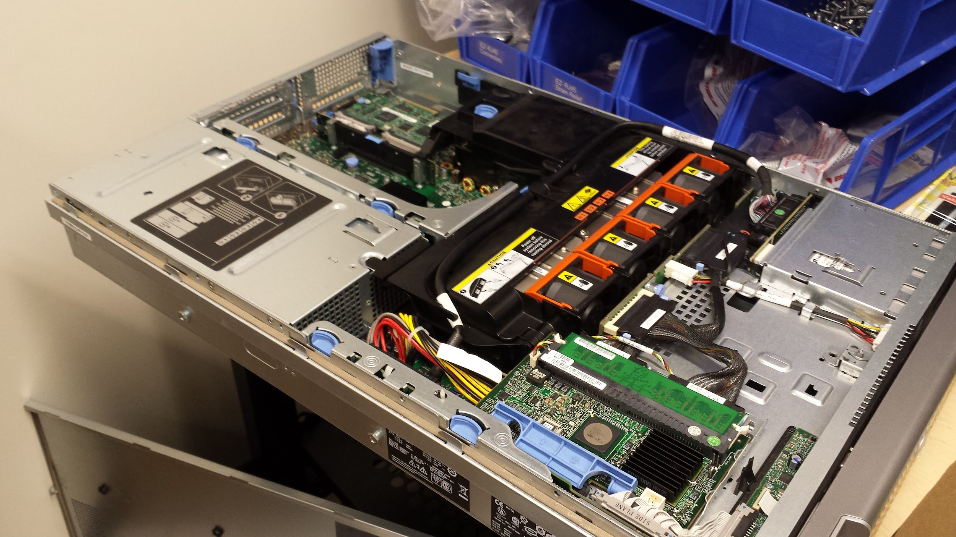
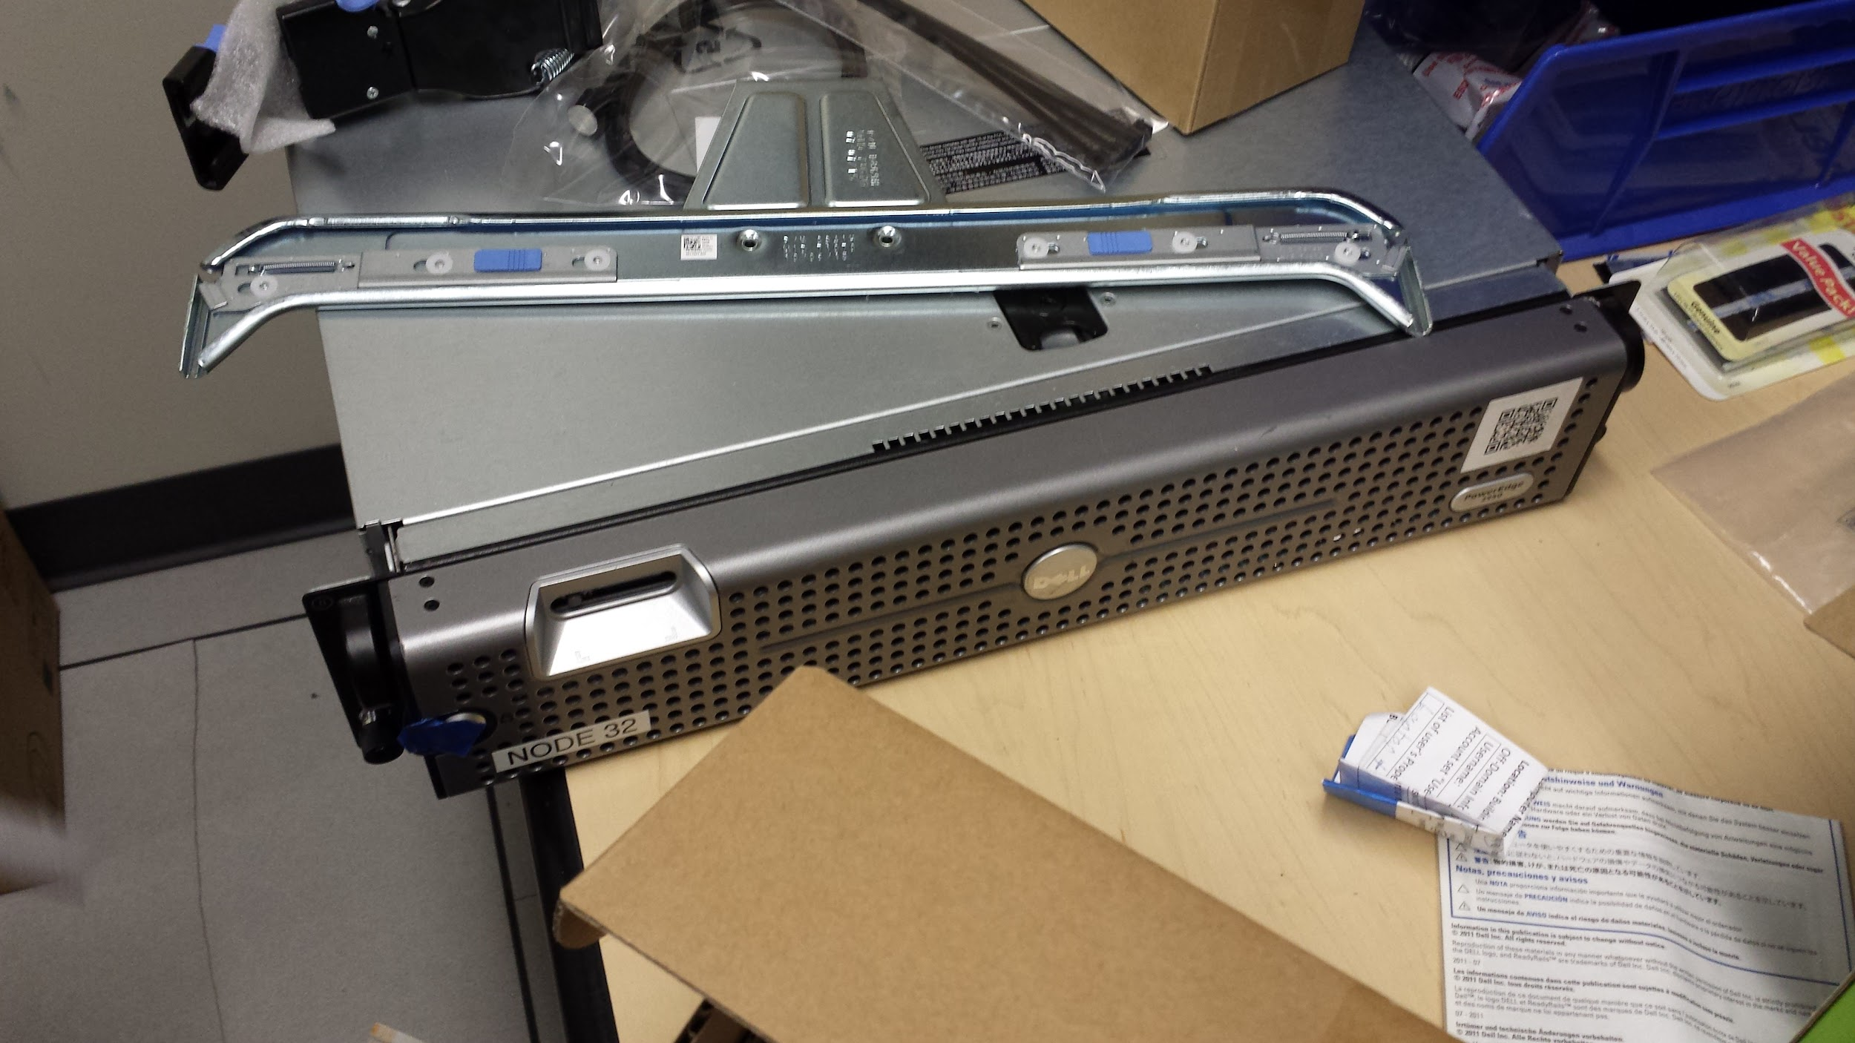
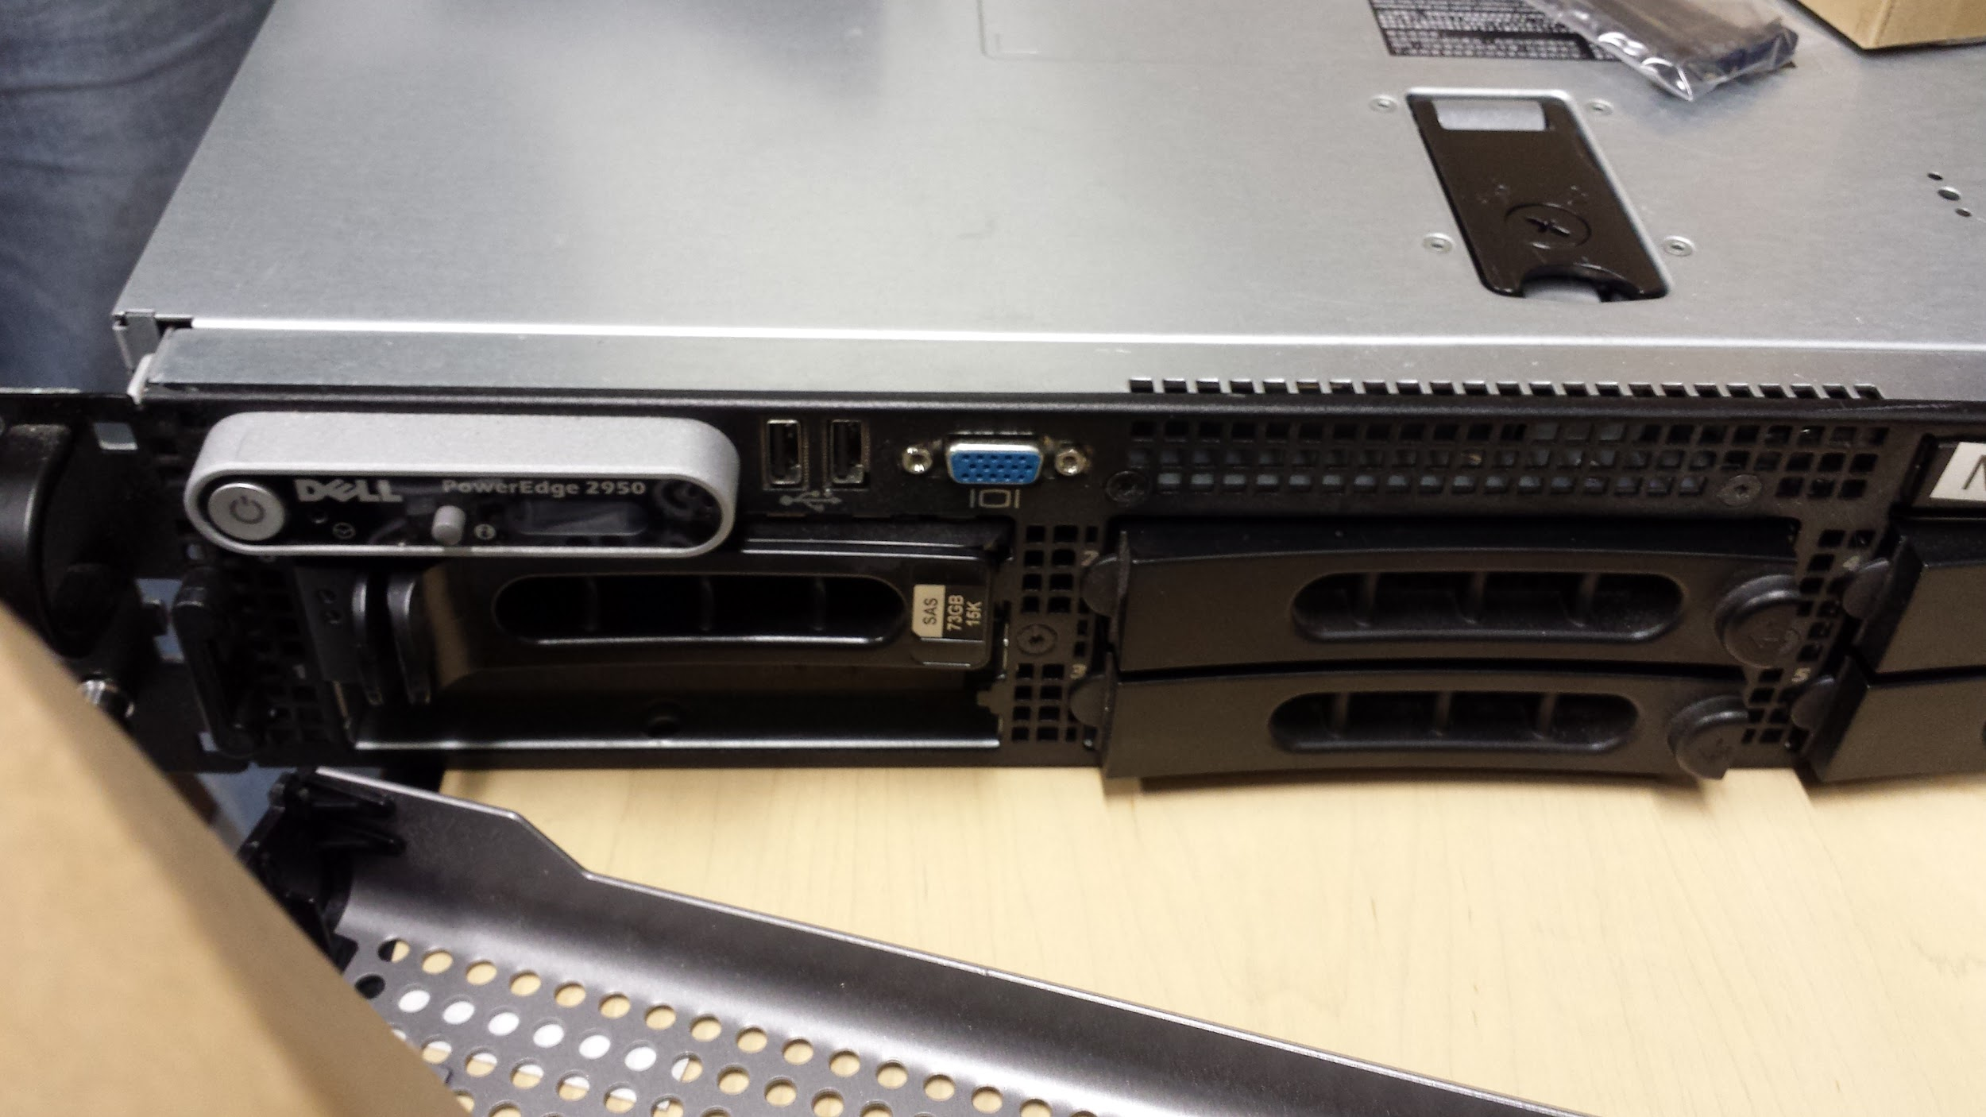
New Server
Notes:
This slide has more than one picture / view it in present mode and you can click through

Slide 5
Special Election
Alex Roberts for Secretary
Anyone else want the role?

Slide 6
Users Forum
https://mtulug.slack.com/
One of blingall’s ‘ASUS PB287Q 4k UHD LED Monitor with 3840X2160 Resolution (Black, 28-Inch)’ decided it wanted to be a police officer…
https://www.youtube.com/watch?v=whfYZrCpmp4
Caution Lower your volume 99% of the way
The noise is ear splitting

Slide 7
Spooky Blue vs Red Team Presentation
blingall has configured a VM and will show some common Blue/Red team techniques for attack and defend

